Slide 1
.
TEAM TINY CODERS
EMPLOYMENT MANAGEMENT SYSTEMilekamparya Vamsee

Slide 2


TEAM MEMBERS
Chilekampalli Sri Harshitha E21CSEU0261
Dasari Anush Reddy E21CSEU0270
Chithirala Karthik E21CSEU0263
Chitrakavi Surya Vamsee E21CSEU0264

Slide 3
.
INTRODUCTION:
This Employee Management System stores information about its employees in its organization.
This contains employee information like employee id, name, salary, contact number , email id.
It is simple to use and to update any employee information.
Previously, employee records were stored manually, requiring a great deal of paper effort; however, this system accomplishes the task while saving time.
It is simple to use and to update any employee information It contains employee information like employee id,
It contains employee information like employee id,
It contains employee information like employee id,
It contains employee information like employee id,
It contains employee information like employee id,

Slide 4
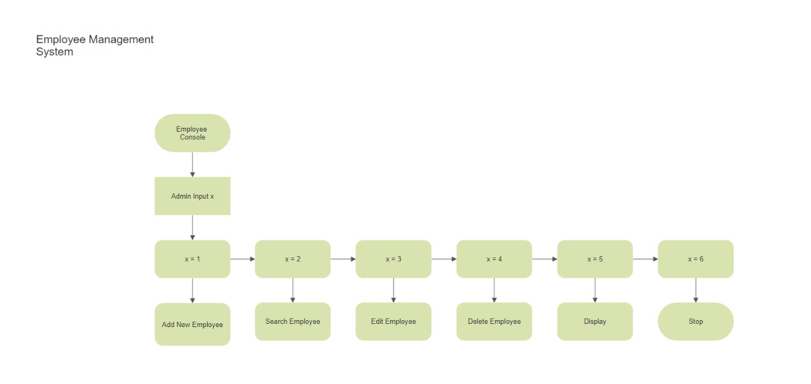
FLOW CHART

Slide 5
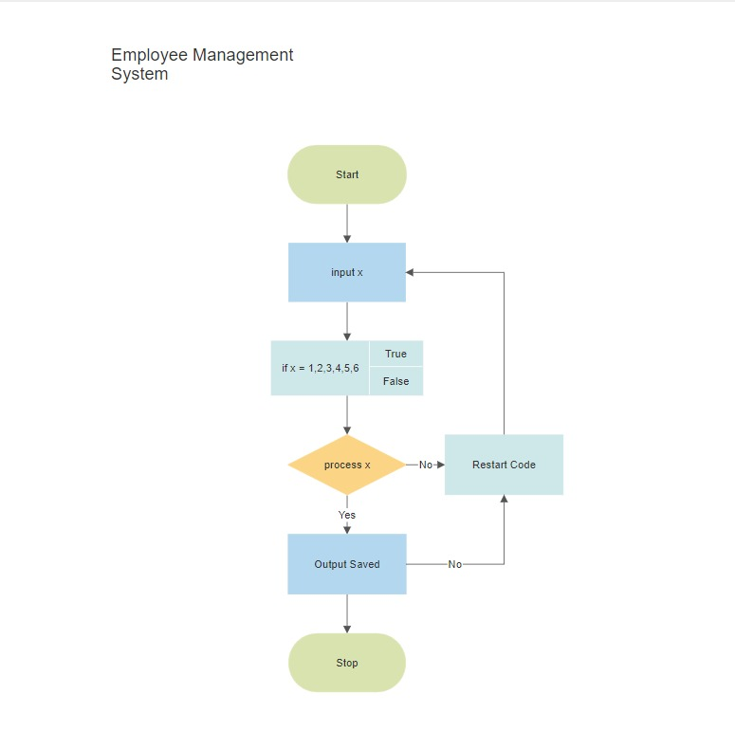
FLOW CHART 2

Slide 6
Planned individual contribution
Harshitha-Programming and Implementation and Presentation
Anush-Designing and Programming
Karthik-Research and Analyzing
Vamsee- Programming

Slide 7

.
THANK YOU!

